Slide 1

Project Management Roundtable Discussion
Hosted by Justin Wasser
Attendees: Ansumana Tangar, Rebecca Telljohn, Adam Williams, Cordarius Woods, & Suzanne Zelnis
8/6/2023
UMGC
ITEC 640
Notes:
Hello, I’d like to start by thanking all the attendees of today's UMGC IT Project Management Final Exam roundtable discussion. My name is Justin Wasser, today’s date is August, 6th 2023 and I will be leading the discussion today.

Slide 2
Presentation Schedule
Introduction & justification for chosen topics
Analysis of topics
Conclusion
Notes:
I will begin this presentation with an introduction to the topics to be discussed and justify why their inclusion in this presentation is merited.
Next, I will go into the specific details about each topic and how they relate to effective project management.
Lastly, I will present my conclusion.

Slide 3
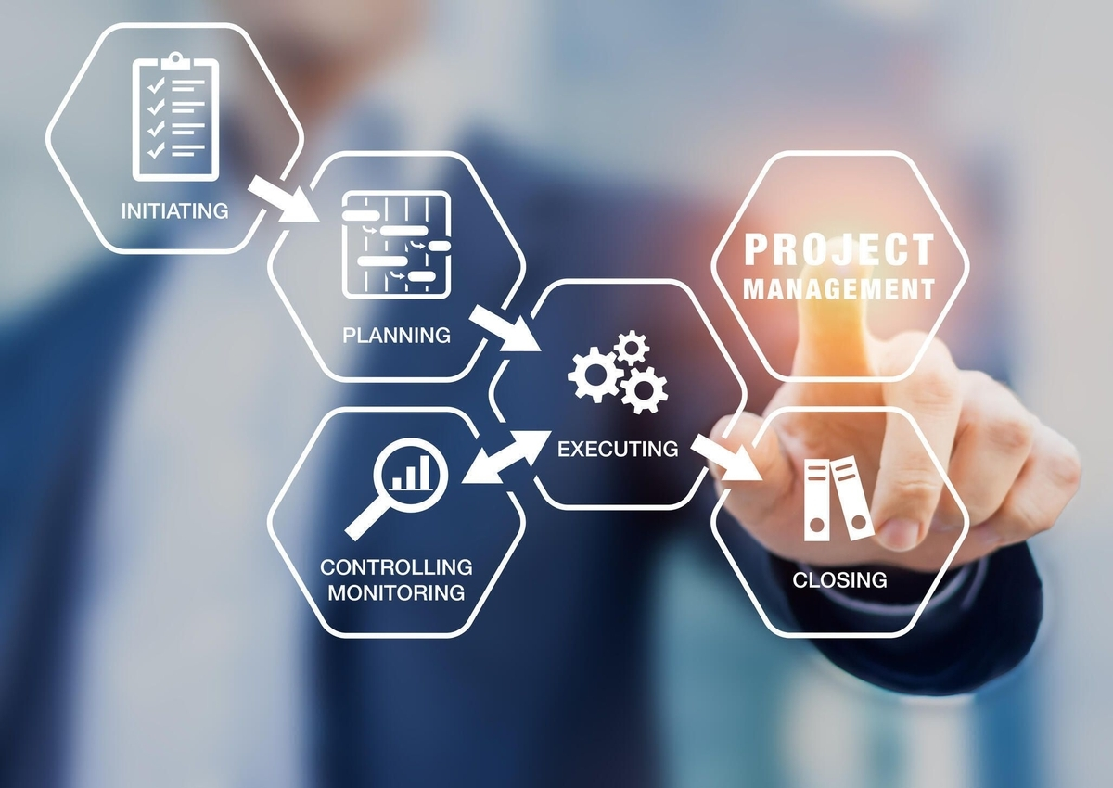
Introduction
(Alexander, 2018)
Notes:
The purpose of this roundtable discussion is to identify a few of the most important skills a project manager should possess and how those skills are applied during different phases of an IT project’s lifecycle to complete a given project.
This topic is important to discuss as Information Technology projects are often large undertakings, so large in fact that “17% of IT projects can go so bad that they can threaten the very existence of the company” (Andriole, 2020). Moreover, IT projects are notoriously difficult to manage as exemplified by the fact that according to La Paz & López (2023), they are more likely to fail than succeed. Moreover, another report stated that “over 30 percent of new software projects are canceled before completion, and that over half are more than 180 percent over budget” (Olson, 2014).

Slide 4
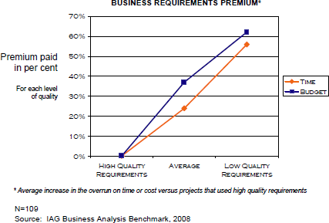
Justification of chosen topics
The ability of the project manager to elicit accurate project requirements directly correlates to project success factors (Krigsman, 2009; Kate, 2021).
(Krigsman, 2009)
Notes:
Although some may have assumed the low success rates of IT projects is due to their complexity, it has been found that the relative ability of the project manager to elicit accurate project requirements more directly correlates to project success factors (Krigsman, 2009; Olson, 2014).
To that point, the topics chosen directly relate to both a project manager’s ability to elicit precise project requirements and their ability to overcome obstacles to deliver on those requirements.

Slide 5
Topics
Project Management Skills
Project Lifecycle Activities
Communication & Leadership
Problem-Solving
Organization
(Nance & Howard, n.d.-a)
Requirements Gathering & Joint Application Development (JAD)
Stakeholder Analysis
Stakeholder Management
(Emoghene & Ogwueleka , 2017; Nance & Howard, n.d.-b; Olson, 2014)
Notes:
The topics being discussed today include three crucial skills needed by all project managers and how they relate to effectively navigating different phases of a project’s lifecycle.
The specific skills being discussed today will be communication, problem-solving, and organization (Nance & Howard, n.d.-a; Olson, 2014). Furthermore, these skills will be discussed in relation to the practices of requirements gathering, stakeholder analysis, stakeholder management, and joint application development (JAD) (Emoghene & Ogwueleka , 2017; Nance & Howard, n.d.-b; Olson, 2014)
As just mentioned, IT projects are often very costly endeavors that have high rates of failure relative to other types of projects, but this has been shown to result from a lack of project management skills as opposed to due to the technical complexity of an IT project (Krigsman, 2009).
Therefore, it is important to discuss the correlation between a project manager’s aptitude and the odds of successfully completing a given project. To that point, project managers that possess strong communication, problem-solving, and organizational skills will be more effective in requirements gathering, stakeholder analysis, and stakeholder management,(Nance & Howard, n.d-a.; Olson, 2014). Moreover, being more effective at those project life cycle activities will lead to higher project success rates (Ahmad & Xu, 2021; Krigsman, 2009; Nance & Howard, n.d.-a).

Slide 6

Communication & Leadership
Factors that influence communication and/or leadership styles
Audience (Stakeholder vs Team member)
Individual personalities
Phase of the project lifecycle
(Nance & Howard, n.d.; Watt, 2014)
(Sprimont, n.d.)
Notes:
Communication plays a vital role in almost every aspect of project management. Whether it is communicating with subordinate team members about how to accomplish a task or discussing project requirements with top stakeholders, effective communication is needed to make sure expectations are being accurately conveyed (Nance & Howard, n.d.-a; Watt, 2014). Although different styles of communication should be employed by a skilled project manager depending on the person or group they are communicating with (Nance & Howard, n.d.-a; Watt, 2014).
For example, depending on their personalities, different project team members may respond better to a direct communication/leadership style while others may respond more favorably to a more supportive style of communication (Nance & Howard, n.d.-a). However, when communicating with stakeholders a project manager is much more likely to employ a deferential tone (Nguyen et al., 2023). Additionally, communication skills and leadership abilities overlap when dealing with project team members (Nance & Howard, n.d.-a).
Furthermore, the stage in a project may also dictate the urgency with which information is communicated, as well as the leadership style employed (Nance & Howard, n.d.-a).
One situation where clear communication is of the utmost importance is during the requirements-gathering phase of the project lifecycle (Olson, 2014).

Slide 7
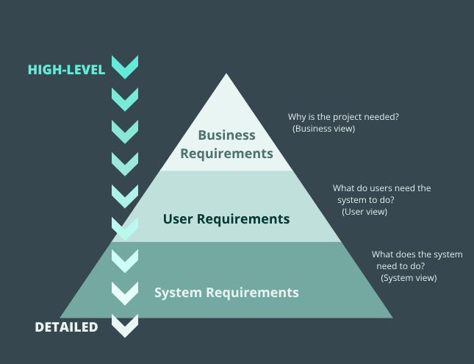
Requirements Gathering
Accurate project requirements are the key to achieving project success (Krigsman, 2009).
Eliciting and conveying project requirements requires excellent communication skills (Emoghene & Ogwueleka , 2017; Watt, 2014).
(Kate, 2021)
Notes:
Requirements gathering is closely related to project scope as requirements gathering leads to defining a project’s scope (Nance & Howard, n.d.-b).
Accurate project requirements are the key to achieving project success as a project will have almost no chance of being successful without accurate project requirements (Krigsman, 2009). Furthermore, eliciting and conveying project requirements requires excellent communication skills (Emoghene & Ogwueleka , 2017; Watt, 2014).
Communication skills are at a premium during requirements gathering as three different levels of requirements, as illustrated on the slide, must fit with one another for the project to be feasible (Kate, 2021). Effectively communicating with all the different stakeholders (of varying influence) each with their own desires for the project deliverables is an extremely difficult task for the project manager (Olson, 2014). Furthermore, communicating the requirements that have been gathered is essential to a project’s success because “if the project scope is not clear to everyone, those who make decisions related to the project will not be in a position to make the best decisions” (Olson, 2014).

Slide 8

Joint Application Development (JAD)
(Akhil, n.d.)
Notes:
One solution to this issue is to employ the joint application development (JAD) technique for requirements gathering as joint application development facilitates communication between all levels of stakeholders (Emoghene & Ogwueleka , 2017).
To that point, a study conducted on various methods for gathering project requirements found that joint application development was rated as one of the most effective techniques for eliciting project requirements (Emoghene & Ogwueleka , 2017).
Furthermore, the collaborative approach employed by joint application development makes any conflicting requirements between stakeholders more easily identifiable (Emoghene & Ogwueleka , 2017). This is also a crucial benefit of the joint application development technique as it is generally accepted that the earlier conflicts over project requirements are identified, the greater the probability of resolving those conflicts by way of effective communication (Project Management Institute, 2021; Watt, 2014).

Slide 9

Problem-SOlving
Problems may arise for a variety of reasons including:
Difference in personality types
Technical issues
Conflicting project requirements
(Watt, 2014)
(David, 2022)
Notes:
Beyond just conflicting project requirements, it is generally accepted that conflicts of all kinds will inevitably arise during different phases of a project lifecycle (Nance & Howard, n.d.-c).
Problems may arise for a variety of reasons including, differences in personality types, differences in opinion regarding technical specifications, and conflicting project requirements from different stakeholders (Watt, 2014).
To resolve interpersonal conflict among team members or between team members and the project manager exceptional communication and leadership skills are required (Watt, 2014). To that point, solving problems between individuals usually requires garnering their support (Watt, 2014). One way to garner support is to “involve team members in project planning” (Watt, 2014) so they feel like they have more ownership of the project (Watt, 2014). Another way to garner support is by keeping team members informed about a project’s “key decisions” (Nance & Howard, n.d.-c) including any changes made to project deliverables (Nance & Howard, n.d.-c). Furthermore, as a project manager, having an open-door policy to hear team members’ concerns anytime will also help gain the trust and respect of the team members (Watt, 2014). Lastly, setting up some private one on one meetings with team members may help turn an opponent into an ally (Watt, 2014).
Fortunately for a project manager, as opposed to interpersonal conflicts there is a much more straightforward approach for resolving any technical issues that may arise during the project lifecycle (Nance & Howard, n.d.-a). The “problem solving cycle” (Nance & Howard, n.d.-a) involves identifying the “status quo” (Nance & Howard, n.d.-a) or “current state of affairs” (Nance & Howard, n.d.-a), then “identifies the problem to be solved” (Nance & Howard, n.d.-a), next a “technical development” (Nance & Howard, n.d.-a) is introduced which remedies the identified problem (Nance & Howard, n.d.-a). Lastly, the technical development is integrated into the larger system, thereby delivering the solution (Nance & Howard, n.d.-a).
Finally, another problem that a project manager must be ready to solve involves when different stakeholders disagree regarding project deliverables (Watt, 2014). To that point, this is such an important topic that a large portion of “stakeholder management” (Watt, 2014) is devoted to solving this issue (Watt, 2014). However, stakeholder management cannot be meaningfully discussed without discussing stakeholder analysis first.

Slide 10
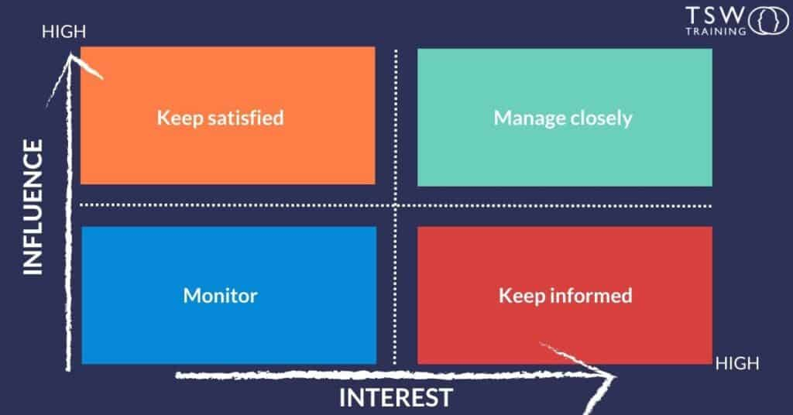
Stakeholder ANalysis
The influence & interest level of a stakeholder are the two most important factors in determining the type of engagement that a given stakeholder receives (Project Management Institute, 2021).
(Wallbridge, 2023)
Notes:
Stakeholder analysis and stakeholder management should be discussed together within the context of problem-solving as the analysis of a given stakeholder informs the communication strategy used to engage with that individual or group (Project Management Institute, 2021).
First off, there are a few different theories on how to approach stakeholder analysis, however, the general consensus is that different stakeholder groups have an effect on one another and therefore, the methodology used for analysis should take into account the relationship between parties (Zarghami & Dumrak, 2020).
The purpose of stakeholder analysis is to help rank and understand the goals of project stakeholders to be able to communicate more successfully with each person or group (Project Management Institute, 2021).
In practice, stakeholder analysis requires grading the power/influence of a party in tandem with their interest level (Project Management Institute, 2021). A rudimentary version of this influence/interest matrix is presented before you and it is the single most important factor in determining the style of management/engagement that a given stakeholder receives (Project Management Institute, 2021). However, other information is also gathered from stakeholder analysis, such as if a party is an ally or opponent of a project, their assumptions about a project, and their relationships with other stakeholders; the totality of this information helps inform the management strategy employed for a specific individual or group (Project Management Institute, 2021).
Furthermore, communication plays a key role in effective stakeholder analysis as stakeholder profiles are dynamic, and therefore they are subject to change as a project progresses (Missonier, 2014). Therefore, effective communication between the project manager and powerful individuals or groups is key to quickly recognizing those shifts and reacting effectively (Missonier, 2014).

Slide 11
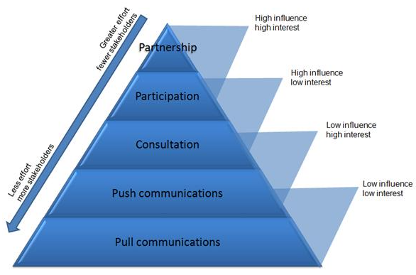
Stakeholder Management
Stakeholder management involves engaging with stakeholders and it is the ultimate test of a project manager’s communication and problem-solving skills (Project Management Institute, 2021).
(stakeholdermap.com, n.d.)
Notes:
Stakeholder management involves engaging with stakeholders and it is the ultimate test of a project manager’s communication and problem-solving skills (Project Management Institute, 2021). The reason being a somewhat unique communication strategy may be needed to influence an individual or group given the specific project environment (Project Management Institute, 2021).
To that point, effective stakeholder management involves several components:
First, as just discussed, an analysis of all the stakeholders involved informs the environment in which stakeholder management will take place (Watt, 2014).
Next, a hierarchy of stakeholders must be established by the project manager so that they can maximize the utility of their engagement efforts (Watt, 2014). In practice, this means focusing engagement efforts on the most powerful parties, such as the project initiator or the client for whom the project deliverables are intended (Project Management Institute, 2021).
Another component of stakeholder management is understanding “what project success looks like” (Watt, 2014) for every stakeholder (Watt, 2014). Moreover, this circles back to the importance of effective communication so that precise requirements were elicited from the outset of a project (Krigsman, 2009; Watt, 2014).
Furthermore, stakeholder management requires involving stakeholders, especially those with a high level of influence over a project, in key decisions regarding the project (Watt, 2014). Additionally, all parties should be regularly informed about project activities including, progress reports, delays, issues, etc. (Watt, 2014).
Lastly, in situations where stakeholders with an obvious discrepancy in influence/interest are in conflict, the project manager should prioritize the needs of the more influential/interested stakeholder (Project Management Institute, 2021; Watt, 2014). However, if there is a conflict between stakeholders of more similar stature, the project manager must be proactive in addressing the dispute as this will allow more opportunities to achieve a resolution (Bahadorestani et al., 2020). Furthermore, the project manager should employ collaborative communication strategies, such as negotiation and persuasion to attempt to resolve the dispute as collaborative-based conflict resolution has been shown to increase the probability of achieving project success (Sudhakar, 2015).

Slide 12

Organization
Organizational skills allow a project manager to maximize the impact of the rest of their skillset by not spending excess time and energy trying to figure out what they need to work on next (Nance & Howard, n.d.-a).
(clipart library, n.d.)
Notes:
Lastly, exceptional organizational skills are needed by a project manager to be able to perform all of their duties in a timely manner to keep a project on schedule (Nance & Howard, n.d.-a). To that point, the topics reviewed are just a small sampling of the responsibilities that a project manager must perform. Therefore, it is not feasible for someone without great organizational skills to be able to keep track of and accomplish all of the tasks that a project manager is responsible for (Nance & Howard, n.d.-a; Watt, 2014).
Moreover, organizational skills allow a project manager to maximize the impact of the rest of their skillset by not spending excess time and energy trying to figure out what they need to work on next (Nance & Howard, n.d.-a).

Slide 13
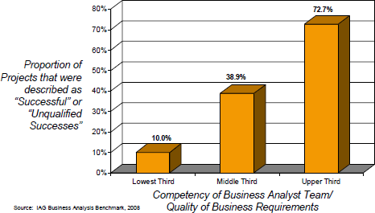
Conclusion
There may be no single more important activity than accurately gathering project requirements (Krigsman, 2009).
Furthermore, the project management skill most needed to accomplish this task is exceptional communication skills (Kate, 2021).
(Krigsman, 2009)
Notes:
In conclusion, the project management skills reviewed, which were, communication, leadership, and problem-solving all directly related to some of the most important aspects of project management which are requirements gathering, stakeholder analysis, and stakeholder management (Project Management Institute, 2021).
To that point, as illustrated by the graph presented, there may be no single more important activity in relation to a project’s success probability than accurately gathering project requirements (Krigsman, 2009). Furthermore, the project management skill most needed to accomplish this task is exceptional communication skills (Kate, 2021).
Additionally, at some point during the project lifecycle it is likely that conflict will arise either between project team members and/or between stakeholders (Nance & Howard, n.d.-c). Therefore, to deliver on the project requirements gathered, the project manager must be able to resolve all types of problems using their communication and leadership skills (Nance & Howard, n.d.-a).
Lastly, it is not feasible for a project manager lacking organizational skills to be able to balance and manage all of the responsibilities covered in this presentation in addition to their numerous other responsibilities that were not discussed today (Nance & Howard, n.d.-a; Watt, 2014).

Slide 14

(jrossrecruiters.com, 2018)
Notes:
Does anyone from the audience have any questions?

Slide 15
References
Ahmad, S., & Xu, B. (2021). A cognitive mapping approach to analyse stakeholders’ perspectives on sustainable aviation fuels. Transportation Research Part D: Transport and Environment, 100, 103076. https://doi.org/10.1016/j.trd.2021.103076
Akhil. (n.d.). What is Joint Application Development (JAD)? - Explained. Www.fegno.com. Retrieved August 3, 2023, from https://www.fegno.com/what-is-joint-application-development-jad/
Alexander, M. (2018, March 20). What is a project manager responsible for? Here’s everything you need to know. TechRepublic. https://www.techrepublic.com/article/what-is-a-project-manager-responsible-for-heres-everything-you-need-to-know/
Andriole, S. (2020, December 1). Why No One Can Manage Projects, Especially Technology Projects. Forbes. https://www.forbes.com/sites/steveandriole/2020/12/01/why-no-one-can-manage-projects-especially-technology-projects/?sh=4e53e9af2da2

Slide 16
References
Bahadorestani, A., Naderpajouh, N., & Sadiq, R. (2020). Planning for sustainable stakeholder engagement based on the assessment of conflicting interests in projects. Journal of Cleaner Production, 242(1), 118402. https://doi.org/10.1016/j.jclepro.2019.118402
clipart library. (n.d.). Clipart-Library. Retrieved August 5, 2023, from https://clipart-library.com/clipart/7671.htm
David, V. (2022, August 18). How to Solve Problems at Work (with Examples). Careeraddict.com. https://www.careeraddict.com/problem-solving-skills
Emoghene, O., & Ogwueleka , F. (2017). Information Gathering Methods and Tools: A Comparative Study. The IUP Journal of Information Technology, Vol. XIII(No. 4), 51–62. https://www.researchgate.net/publication/326688869_Information_Gathering_Methods_and_Tools_A_Comparative_Study/link/5b5f06280f7e9bc79a6ed18a/download

Slide 17
References
jrossrecruiters.com. (2018, March 22). Interview Questions to Ask the Hiring Manager - Blog Post by Jackie Ross at jrossrecruiters.com. JRoss Recruiters. https://jrossrecruiters.com/blog/interview-questions-ask-hiring-manager
Kate. (2021, December 2). Requirements: How do they Impact the Project’s Success? SapientPro. https://sapient.pro/blog/requirements-how-do-they-impact-the-projects-success/
Krigsman, M. (2009, January 13). Study: 68 percent of IT projects fail. ZDNet; ZDNet. https://www.zdnet.com/article/study-68-percent-of-it-projects-fail/
La Paz, A. I., & López, R. I. (2023). Recommendation method for customized IT project management. Procedia Computer Science, 219, 1938–1945. https://doi.org/10.1016/j.procs.2023.01.493

Slide 18
References
Missonier, S. (2014). Stakeholder analysis and engagement in projects: From stakeholder relational perspective to stakeholder relational ontology. International Journal of Project Management, 32(7), 1108–1122. http://dx.doi.org/10.1016/j.ijproman.2014.02.010
Nance , K., & Howard, C. (n.d.-a). Lesson 2. UMGC. Retrieved August 2, 2023, from https://learn.umgc.edu/d2l/le/content/769734/viewContent/30764316/View
Nance , K., & Howard, C. (n.d.-b). Lesson 4 - Requirements Management. UMGC. Retrieved August 3, 2023, from https://learn.umgc.edu/d2l/le/content/769734/viewContent/30764322/View
Nance , K., & Howard, C. (n.d.-c). Lesson 10 - Conflict Resolution and Project Closure. UMGC. Retrieved August 3, 2023, from https://learn.umgc.edu/d2l/le/content/769734/viewContent/30764365/View

Slide 19
References
Nguyen, T. H. D., Chileshe, N., Rameezdeen, R., & Wood, A. (2023). Strategic responses to external stakeholder influences. International Journal of Project Management, 41(1), 102434. https://doi.org/10.1016/j.ijproman.2022.102434
Olson, D. (2014). Information Systems Project Management (T. Kloppenborg, Ed.). Umgc.edu. http://ezproxy.umgc.edu/login?url=https://search.ebscohost.com/login.aspx?direct=true&db=nlebk&AN=932347&site=eds-live&scope=site&profile=edsebook&ebv=EB&ppid=pp_Cover
Project Management Institute. (2021). Guide to the Project Management Body of Knowledge (7th ed.). Project Management Institute. https://eds-p-ebscohost-com.ezproxy.umgc.edu/eds/detail/detail?vid=1&sid=97dd492d-c42f-4404-bd30-06a433b8582c%40redis&bdata=JnNpdGU9ZWRzLWxpdmUmc2NvcGU9c2l0ZQ%3d%3d#db=nlebk&AN=2942429
Sprimont, J. (n.d.). Effective Communication Strategies: 7 Ways To Improve. Insperity. Retrieved August 2, 2023, from https://www.insperity.com/blog/effective-communication-strategies/

Slide 20
References
stakeholdermap.com. (n.d.). Stakeholder Engagement - Definition and Overview. Stakeholdermap.com. Retrieved August 4, 2023, from https://www.stakeholdermap.com/stakeholder-engagement.html#ment
Sudhakar, G. P. (2015). A Review of Conflict Management Techniques in Projects. Brazilian Journal of Operations & Production Management, 12(2), 214. https://doi.org/10.14488/bjopm.2015.v12.n2.a3

Slide 21
References
Wallbridge, A. (2023, April 13). How To Conduct A Bullet-Proof Stakeholder Analysis Matrix In 4 Useful Steps. TSW Training. https://www.tsw.co.uk/blog/leadership-and-management/stakeholder-analysis-matrix/
Watt, A. (2014). Project management. BCcampus. https://opentextbc.ca/projectmanagement/
Zarghami, S. A., & Dumrak, J. (2020). Reimaging stakeholder analysis in project management: network theory and fuzzy logic applications. Engineering, Construction and Architectural Management, ahead-of-print(ahead-of-print). https://doi.org/10.1108/ecam-06-2020-0391

